Slide 1

SA Survival Kit - Ubuntu
Rick Kauffman Regional Consulting Solutions Architect / June 12, 2014
@netwookie

Slide 2
Introduction
When is comes to DevOps there are many platforms which you could use. If you were one of those “fringe” Solution Architects (you know who you are) you’re probably chomping at the bit to get your commodore 64 ready for action. For the rest of us (who are actually from this planet) there is Linux.
I’m sure you have a favorite “distro” but I have found that there are a lot of applications and support for Ubuntu. In this SA survival Kit we will get Oracle Virtual Box (Please enough with the VMWare moaning, you’ll thank me later) and the latest Ubuntu Desktop and start creating our own super, bad to the bone, DevOps platform.
Disclaimer: There will be some command line Linux involved!

Slide 3
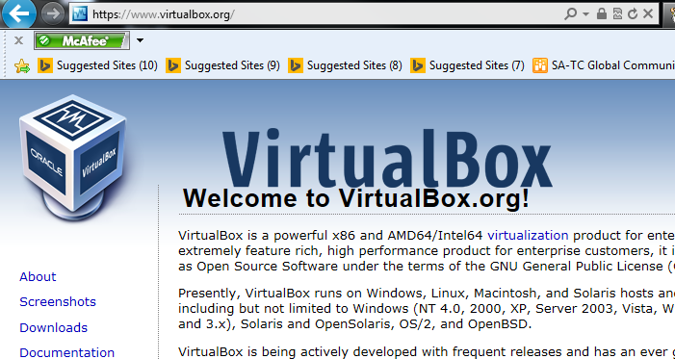
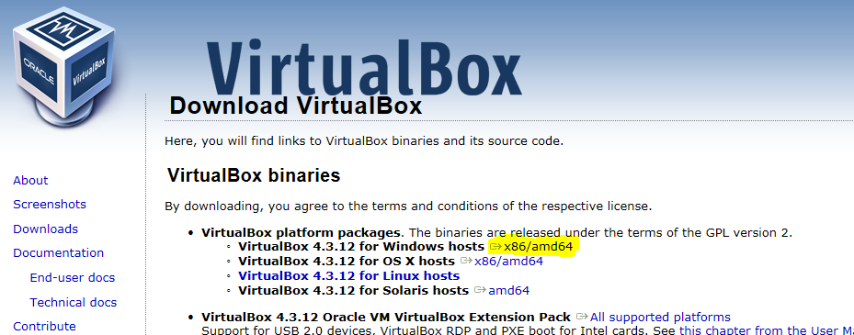
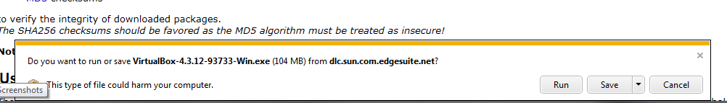
Setup a Oracle Virtual Box
Make your way on over to www.virtualbox.org and look to the left for the “Download” link.
Get the Windows version x86/amd64. Save it to your PC and run the installer.

Slide 4
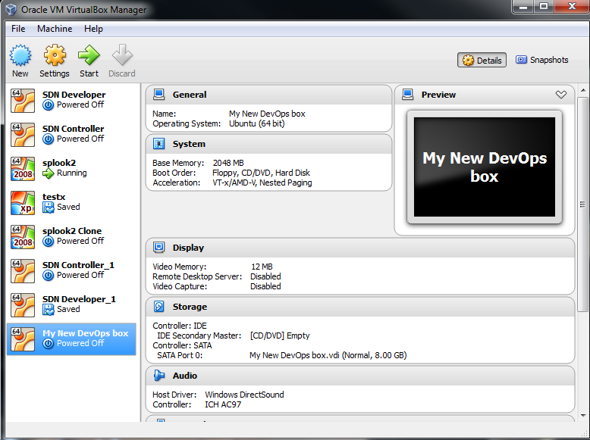
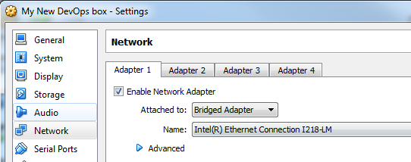
Making one minor adjustment from the defaults
When the network adapter is configured, by default it is set to NAT. We will want to use an IP address for our new DevOps box that is on our lab network. We will have to set the network adapter settings to “Bridged”.
Highlight your VM in the left panel and click on the gear icon to change the settings. Select Network on the left and use the pull down to change the setting to Bridged Adapter.

Slide 5
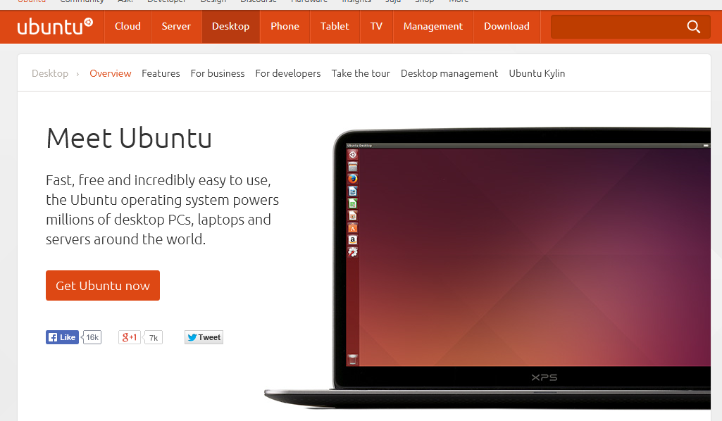
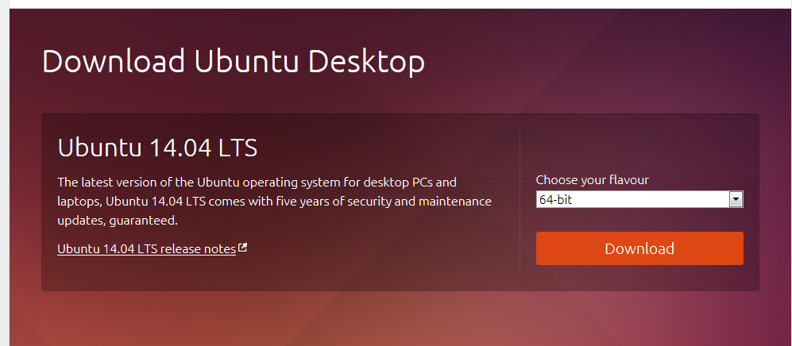
Getting Ubuntu
Open a web browser and enter the URL of www.ubuntu.com/desktop. You will see an orange button that says “Get Ubuntu now”. Get it!
Save the file to a directory you will remember later! Make sure you get the 64-bit version!

Slide 6
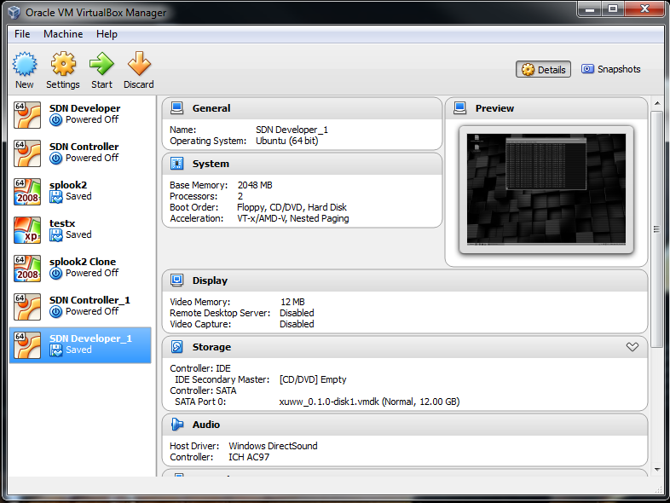
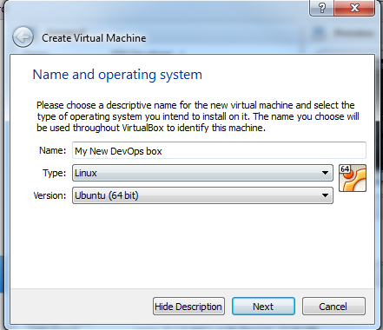
Creating the VM
Open Oracle VirtualBox and from the menu select “Machine/New”
Verify the Type is Linux and the Version is Ubuntu (64 bit) and select “Next”

Slide 7
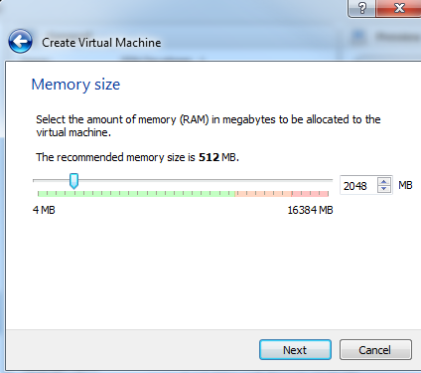
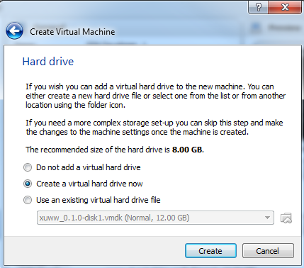
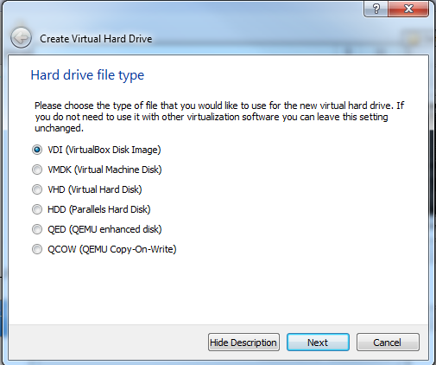
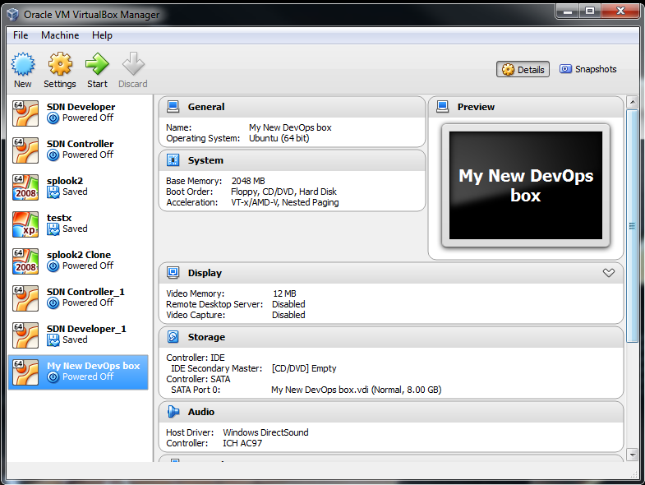
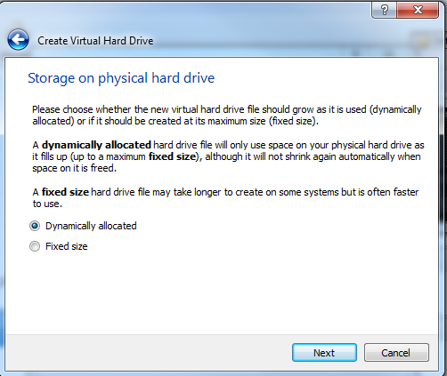
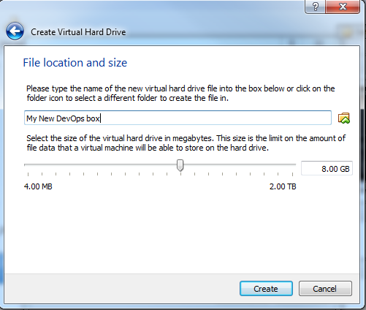
More Ubuntu Settings

Slide 8
Starting the VM
You will need to now “Start” the VM we just created. Do this by clicking once on the VM in the left hand list of VM’s and then clicking on the Green Arrow at the top of the dialog.

Slide 9
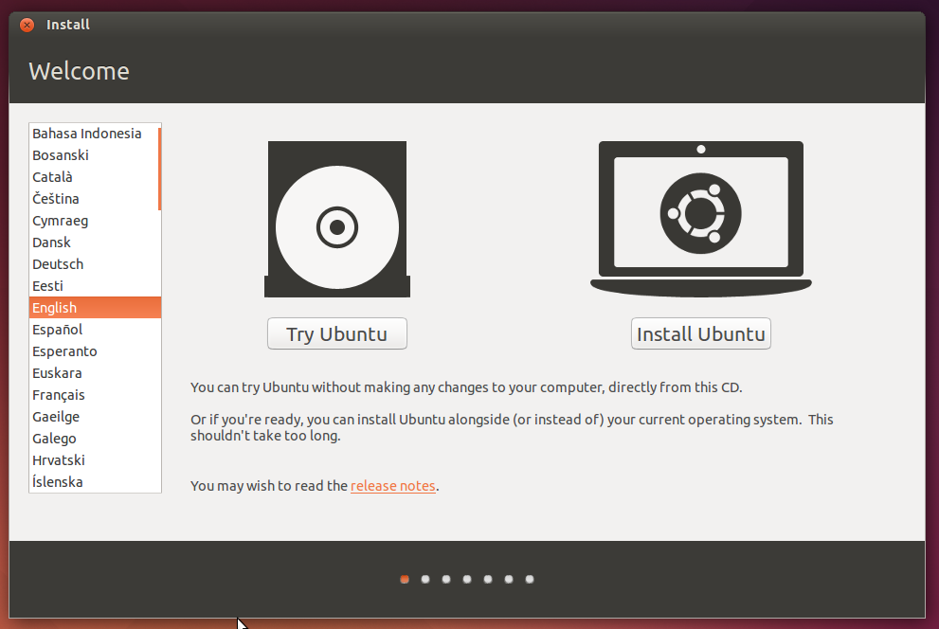
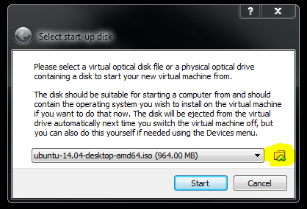
Loading the Ubuntu OS
Use the “Up Arrow” icon and navigate to where you saved the .iso image of Ubuntu. Click on the “Start” button.
From this point forward enter your selections based on your location.

Slide 10
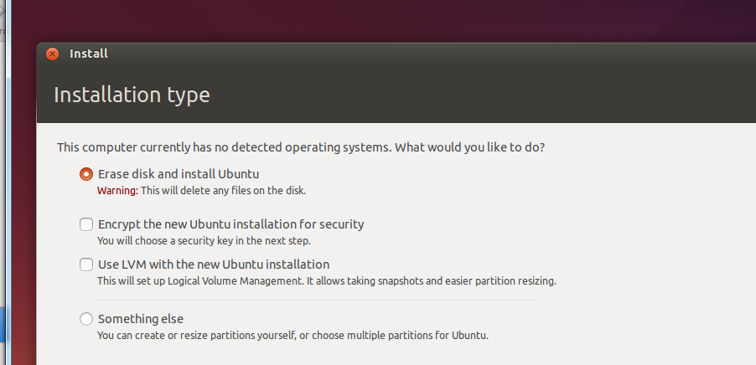
Don’t Panic!!
If you are paying attention you will know that we are creating a 8 Gig virtual disk and it’s OK to “Erase disk and install Ubuntu”. I see why you would be surprised.

Slide 11
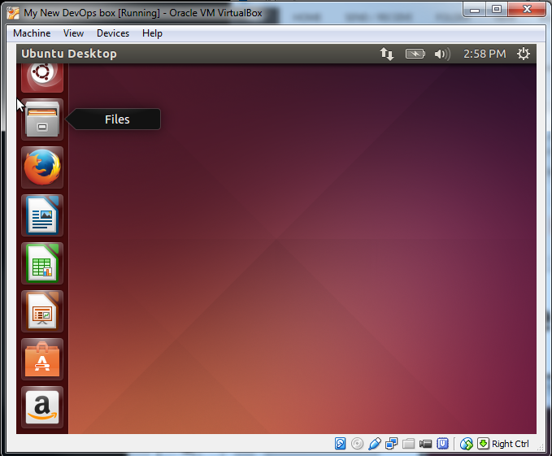
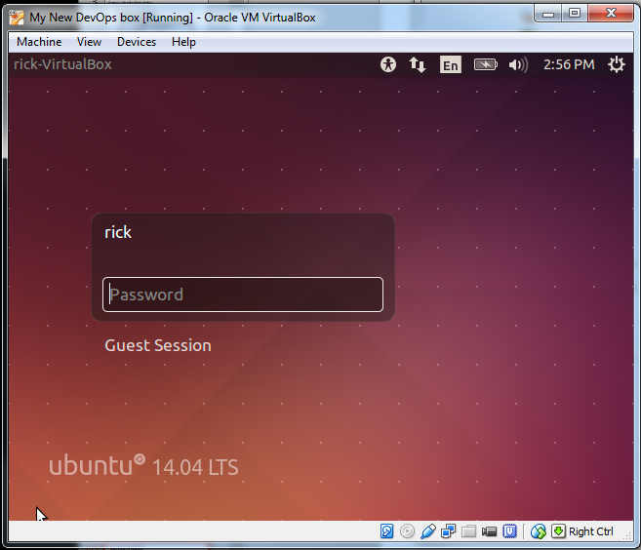
Welcome to Ubuntu
The Unity Desktop
I hope you remembered the password!

Slide 12
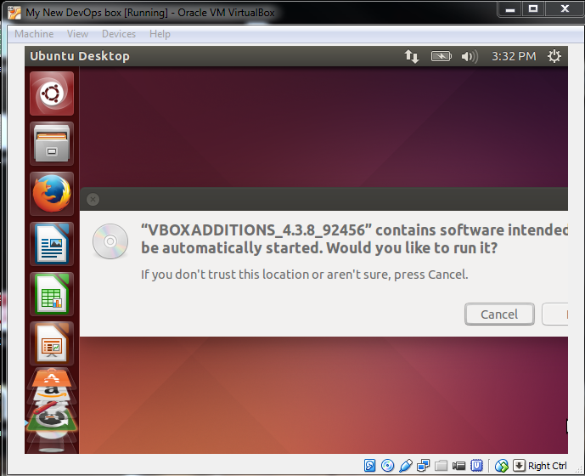
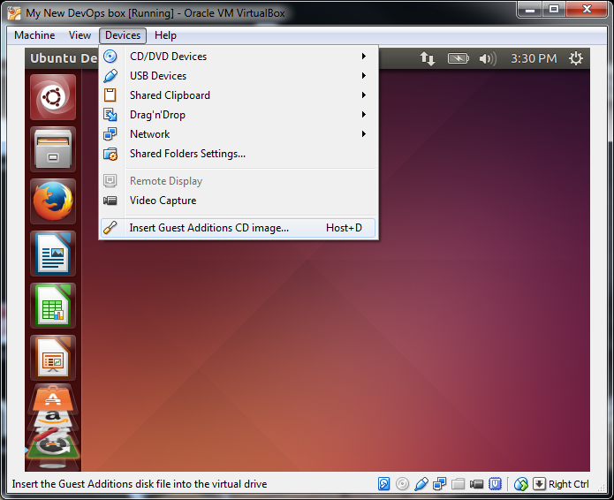
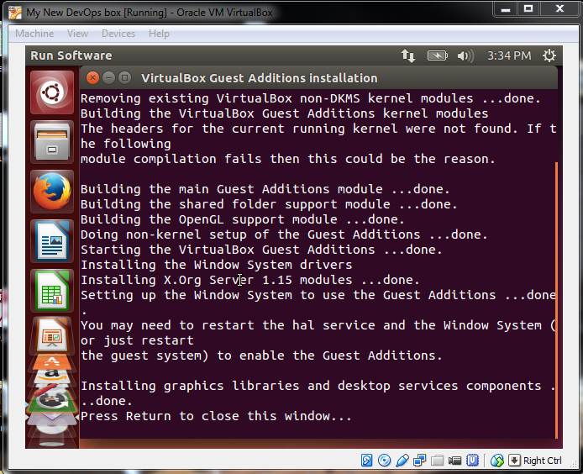
Install Guest Additions (Needed to increase screen size)
From the Devices menu item select the Insert Guest Additions CD image…Host D
Select RUN and enter your Password at the prompt
Press Return to close the window REBOOT!

Slide 13
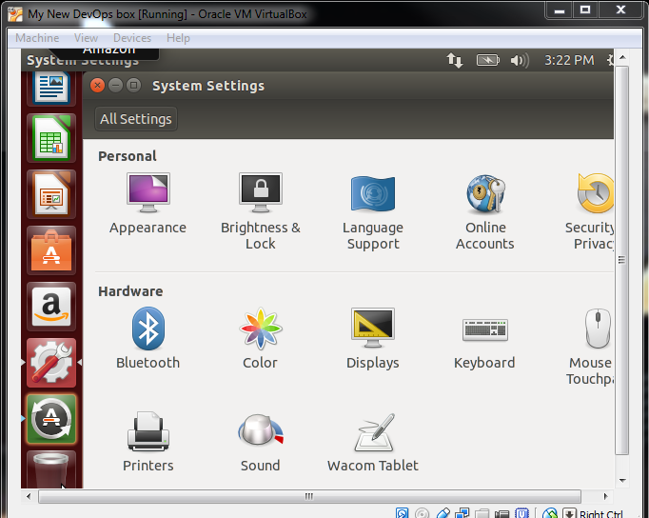
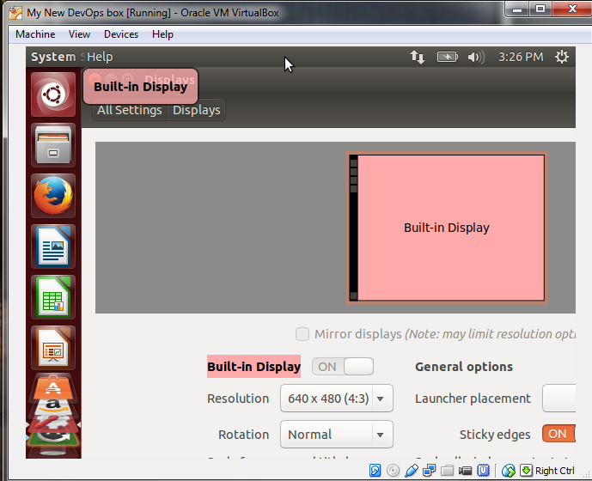
Kick up the screen size
The screen resolution should now be 1024x768. If not, use the System Settings and click on the Display icon. Locate the resolution and increase it to your liking.

Slide 14
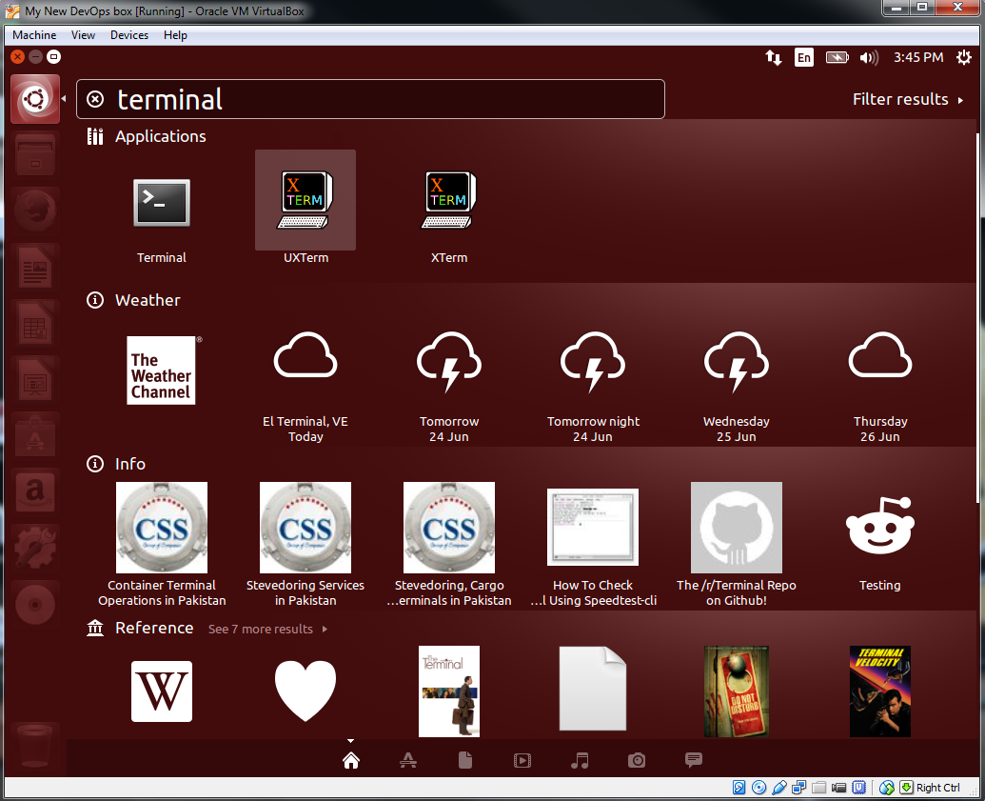
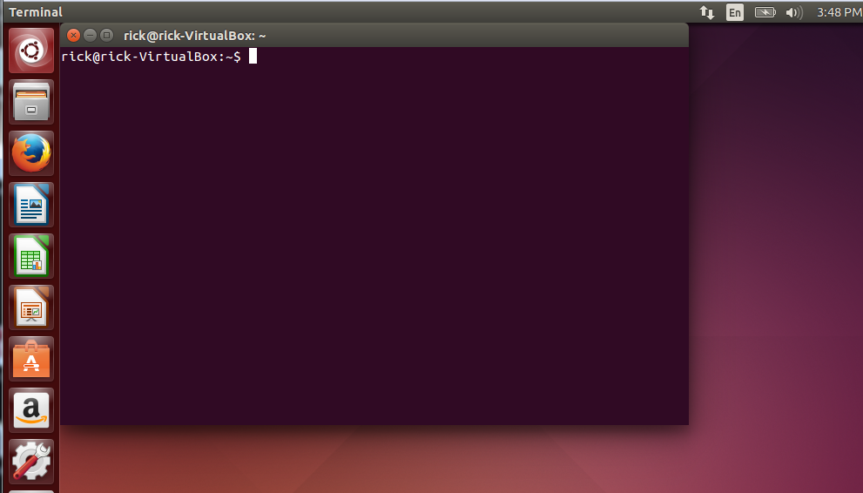
Terminal window
Use the top icon on the left to search for the terminal window. This is where we will start using some Linux commands to spruce this interface up a little bit.

Slide 15
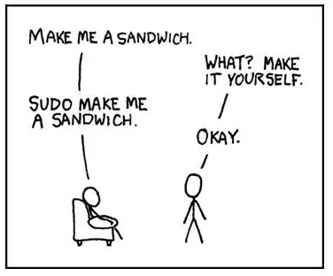
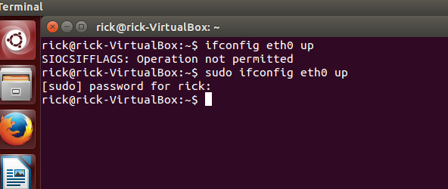
sudo
By default you are not the system operator. To temporarily elevate you permission to execute system commands you will need to sudo. Don’t ask just do….uuhhmmm..sudo.

Slide 16
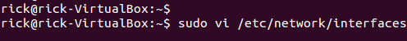
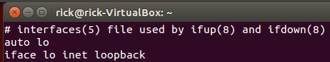
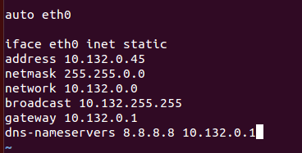
Hard set the IP address for eth0
We are now going to edit the /etc/network/interfaces configuration file to assign a static IP address to our DevOps box. I promise , this will only hurt once!
Vi the file (vi is a native Linux editor
Use the arrow keys, get the cursor to the “K” in loopback and enter “a” to append, then enter twice!
Just type regularly and enter your specific information. When you finish hit the “ESC” key, “SHIFT :” and “wq” for write/quit
(omit quotes)
Restart the networking service…did you sudo?

Slide 17
Get a better looking Desktop, Seriously!
Enter these commands in the terminal window to download the MATE desktop for Ubuntu. Cinnamon used to be a great desktop but the discontinued support for the PPA….Google it!
Answer “y” to all questions

Slide 18
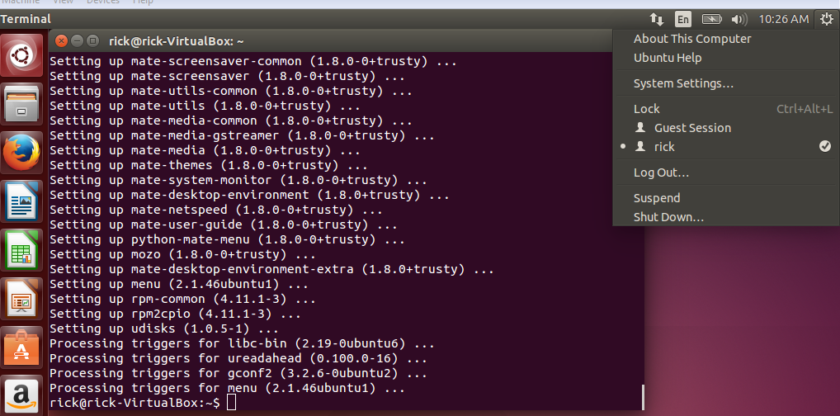
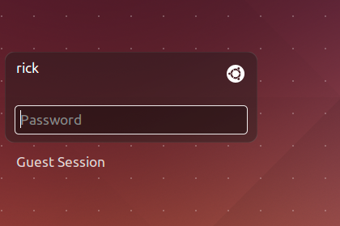
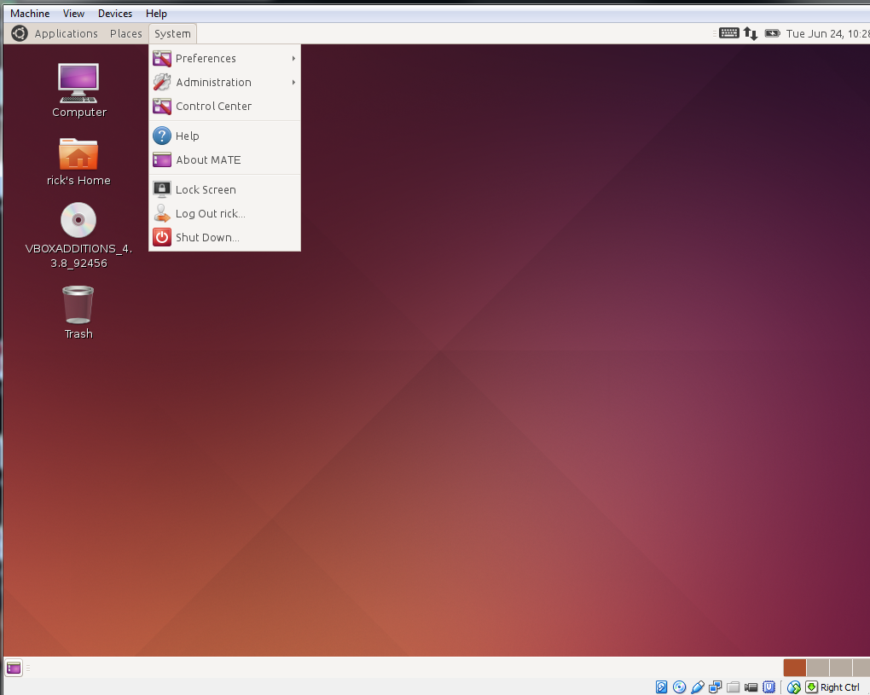
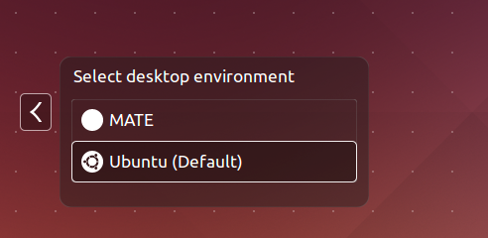
Logout and back in to the Mate Desktop
1
2
4
3

Slide 19
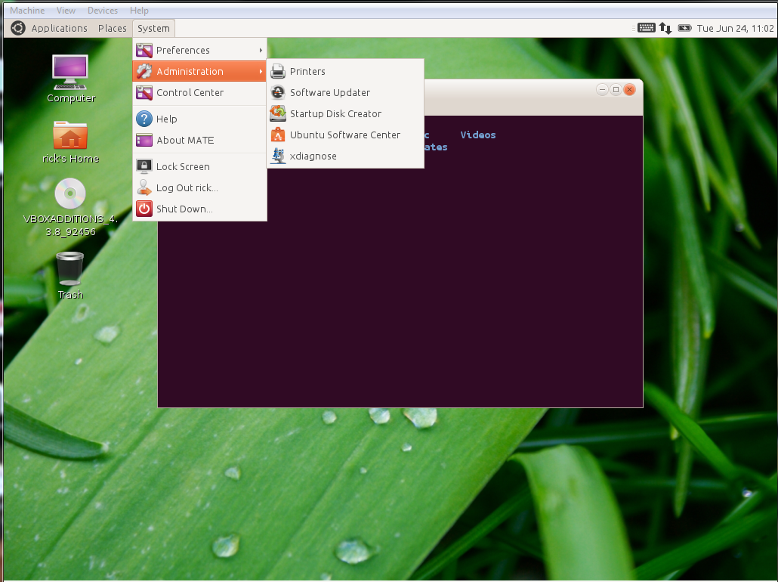
Ubuntu Software Center
Minimum tools to install:
Chromium (Chrome)
Bluefish
FileZilla
Remember: Your drive is only 8Gb….but it’s OK to download Galaga!
Customize: Google Mate Themes!

Slide 20
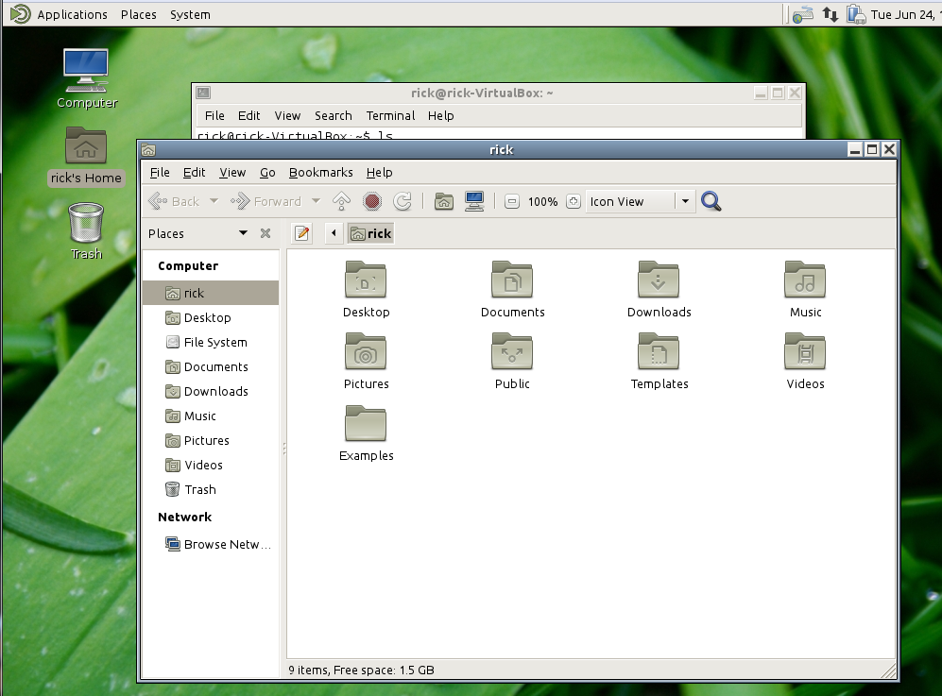
File Browser
Located on the desktop is a graphical file browser and should look and feel a lot like the one you are familiar with in Windows.
Use this is quickly get around the filesystem and get an inventory of files in your home directory.

Slide 21
Home Directory
The Linux filesystem is pretty much the same as Windows. It has a root directory “/” and then everything else under it is a folder. By default you will have a home directory to keep your files in. The directory location is /home/your_user_id. This place in the file system belongs to you. Any files you create will have the file permissions and ownership assigned to your userid.
The important thing to remember is when you are in another file system location YOU MAY NOT BE THE OWNER and not have the appropriate privilege level to execute scripts!!
A hand command line trick is to type pwd. This means “Print Working Directory” Use this on the command line and you will always know where you are at!

Slide 22
Linux File Permissions
Permission Groups
Each file and directory has three user based permission groups:
owner - The Owner permissions apply only the owner of the file or directory, they will not impact the actions of other users.
group - The Group permissions apply only to the group that has been assigned to the file or directory, they will not effect the actions of other users.
all users - The All Users permissions apply to all other users on the system, this is the permission group that you want to watch the most.
Permission Types
Each file or directory has three basic permission types:
read - The Read permission refers to a user's capability to read the contents of the file.
write - The Write permissions refer to a user's capability to write or modify a file or directory.
execute - The Execute permission affects a user's capability to execute a file or view the contents of a directory.
Viewing the Permissions
You can view the permissions by checking the file or directory permissions in your favorite GUI File Manager (which I will not cover here) or by reviewing the output of the \"ls -l\" command while in the terminal and while working in the directory which contains the file or folder. The permission in the command line is displayed as: _rwxrwxrwx 1 owner:group
The important thing to remember is when you are trying to run a script is make sure it is executable! Reference: http://www.linux.com/learn/tutorials/309527-understanding-linux-file-permissions

Slide 23
Where to put things
In your journey to develop something that looks, feels and acts like a real application, you will be dealing with different file types. You can have a host of different webpages on a site but the primary one is called “Index.html” it is the seed page of all websites. This needs to be stored in a specific place and by default (after creating a L.A.M.P. server) is will be…..
/var/www/html This is the directory that you will store the “seed” HTML file.
The scripts you create that will be kicked off from a form on your index.html (if they are python) will end with a “.py” Ex: my_script.py.
/usr/lib/cgi-bin Store python scripts in this directory:

Slide 24
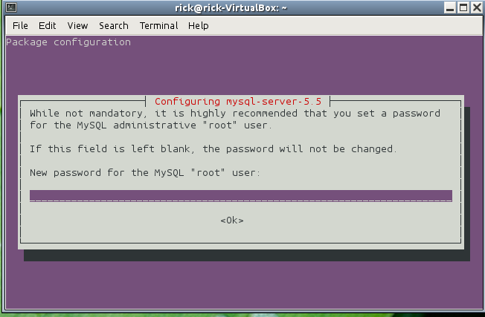
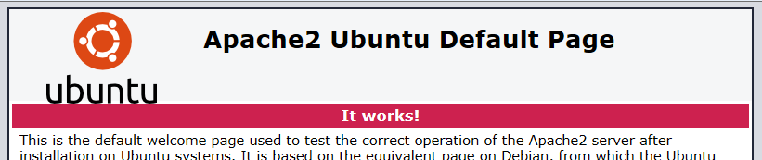
Building a L.A.M.P. server
LAMP stands for Linux, Apache, MySQL and PHP. Once the installation is complete you will have a full blown apache webserver at your disposal.
First refresh your package index...
$ sudo apt-get update
... and then install the LAMP stack:
$ sudo apt-get install lamp-server^
Mind the caret (^) at the end.
When the installation is finished point a web browser from another computer at your DevOps IP address……Do you see…It Works!
Set a password for MySQL admin

Slide 25
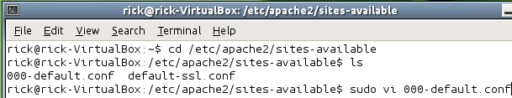
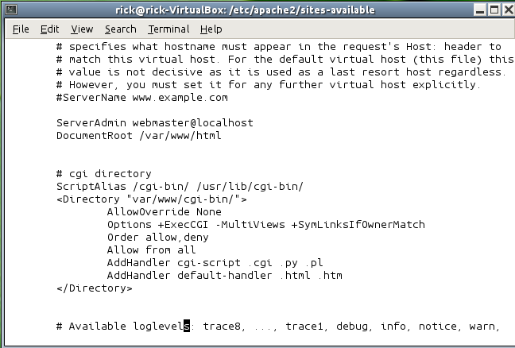
Enabling CGI scripting
We are almost done with setting up this system. The last thing we need to do is configure Apache to know where we will be storing our cgi scripts (python scripts)
We will edit the 000-default.conf file in the /etc/apache2/sites-available directory. Remember to sudo. Anywhere between the <VirtualHost * :80> and </VirtualHost> use the arrow keys to find a spot and press the “i” key for insert. Use normal typing and enter the cgi directory information. To save the file “ESC” and enter “:wq” SUDO, SUDO, SUDO!!!!!!!
Run this command➔sudo a2enmod cgi
Restart apache ➔ sudo service apache2 restart
Order allow,deny…no spaces!!

Slide 26
<Directory /> Options FollowSymLinks AllowOverride All Order deny,allow Allow from all </Directory>
set the options to :Options Indexes FollowSymLinks Includes ExecCGI
Finally, it should look like:
<Directory /> #Options FollowSymLinks Options Indexes FollowSymLinks Includes ExecCGI AllowOverride All Order deny,allow Allow from all </Directory>

Slide 27
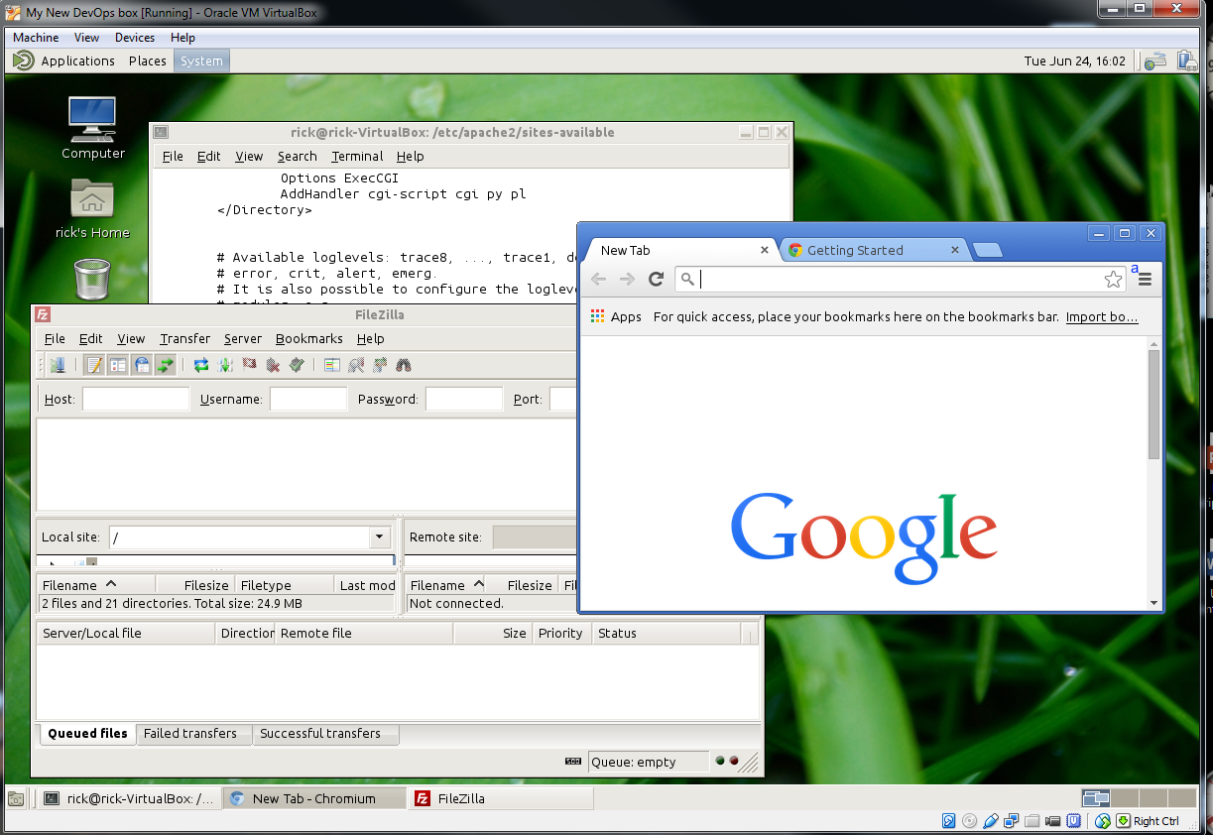
Enjoy your brand new L.A.M.P. DevOps workstation!!

Slide 28
Questions?????
What do you think Google is for? GOOGLE it!!!!

